Slide 1



Slide 2
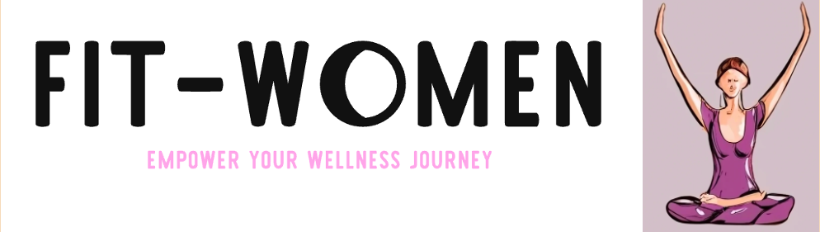

About Company
Fit Women
Fit-Women caters to mid-aged women in India, offering personalized fitness programs, happiness-driven activities, and a supportive community for holistic wellness.
Why ?
Mid-aged women lack fitness options focusing on happiness and community, impacting their holistic well-being.
What ?
Fit-Women provides tailored fitness and joyful activities, fostering a supportive community for mid-aged women's holistic wellness.
How ?
Develop tailored fitness programs and happiness-driven activities.
Cultivate a supportive community through engaging events.
Collaborate with fitness experts for an inclusive environment.
This strategy empowers mid-aged women through fitness, happiness, and lasting connections.

Slide 3
Problem/Opportunity
CONTEXT
The problem occurs when mid-aged women in India experience fitness challenges, isolation, and a lack of happiness and social bonding opportunities.
PROBLEM
The root cause of the problem is the lack of holistic fitness solutions tailored to the unique needs of mid-aged women in India, leading to insufficient physical activity and limited social engagement, impacting their well-being.
ALTERNATIVES
Currently, mid-aged women in India often resort to fragmented fitness routines, solitary workouts, or social activities unrelated to fitness to address their needs for happiness and bonding.
CUSTOMERS
Mid-aged women in India, especially those with busy lifestyles, face the problem most often. They often struggle to balance fitness, happiness, and social bonding in their daily lives.
EMOTIONAL IMPACT
Customers feel empowered, confident, and happier due to improved fitness and social connections. The measurable impact includes metrics like improved well-being (e.g., reduced stress), and enhanced self-esteem (e.g., self-assessment surveys).
QUANTIFIABLE IMPACT
Transforming mid-aged women's lives: Healthier bodies, happier minds, vibrant connections—empowering holistic wellness through fitness and community.
ALTERNATIVE SHORTCOMINGS
Alternative fitness solutions may lack tailored programs, social bonding opportunities, or a focus on happiness. Traditional gyms might not address mid-aged women's holistic wellness needs, leading to dissatisfaction.

Slide 4
Problem Interviews And Surveys Results
We conducted interviews with 50 mid-aged women in India.
The interviews were conducted in person and online.
42 of the interviewed women (84%) expressed a desire for a fitness solution that includes happiness and bonding.
8 of the interviewed women (16%) mentioned they don't need a new fitness solution.
Set of Questions Asked
What is the biggest challenge you face in maintaining your physical fitness?
Lack of time
Lack of motivation
Lack of access to affordable fitness options
How important is it for you to incorporate fun activities and bonding time into your fitness routine?
Very important
Somewhat important
Not important
LINK

Slide 5
Survey Results
How familiar are you with yoga and its benefits?
Very familiar
Somewhat familiar
Not familiar
What is your biggest concern about joining a traditional gym or fitness class?
Cost
Intimidation factor
Lack of flexibility
How likely are you to join a fitness program specifically designed for mid-aged women in India?
Very likely
Somewhat likely
Not likely
LINK

Slide 6
MARKET SIZE
TAM
TAM (Total Addressable Market):
TAM represents the total market demand.
In India, there are approximately 50 million mid-aged women.
This is the overall market potential for fitness, happiness, and bonding services.
SAM (Serviceable Addressable Market):
SAM is the portion of TAM you can realistically target.
We are focusing on urban areas with higher income and fitness awareness.
Roughly 20% of the TAM falls into our SAM.
This means our SAM consists of 10 million mid-aged urban women.
SOM (Serviceable Obtainable Market):
SOM is the market share we can capture within our SAM.
Market research indicates 30% of urban mid-aged women in India use fitness services.
Therefore, our SOM estimate is 3 million potential customers.
This is our immediate, achievable target market.
SAM
SOM
LINK

Slide 7

CUSTOMER PERSONA
Goals
Improve overall fitness and health.
Find enjoyable workouts to relieve stress.
Connect with like-minded women in her community.
Boost self-confidence and body positivity.
Achieve a better work-life balance.
Frustrations
Limited time for fitness due to a demanding job.
Struggles to stay motivated to exercise regularly.
Feels isolated and disconnected from social activities.
Concerned about her physical appearance and self-esteem.
Unable to find fitness programs tailored to her age group.
Bio
Aarti Sharma, 45, is a marketing manager residing in Mumbai, India. She is a dedicated professional, married with two teenagers, and often finds herself overwhelmed with her work and family responsibilities. Aarti has always been health-conscious but has struggled to find the time and motivation to maintain a consistent fitness routine. She feels isolated due to her busy lifestyle and is looking for a fitness solution that not only improves her physical health but also brings happiness and opportunities for social bonding. Aarti is determined to boost her self-confidence and find a better balance between her career and personal well-being.
AARTI SHARMA
AGE : 37
OCCUPATION : PRODUCT MANAGER
LOCATION : URBAN INDIA

Slide 8
VALUE PROPOSITION CANVAS
GAIN CREATORS :
Improved fitness leading to increased confidence.
Meaningful relationships through community engagement.
GAINS :
Improved physical fitness and emotional well-being.
Meaningful connections within a supportive fitness community.
CUSTOMER JOBS :
Seek holistic wellness and fitness solutions.
Crave joyful activities fostering happiness and community bonding.
PRODUCTS AND SERVICES :
Tailored fitness programs for mid-aged women.
Happiness-driven activities like yoga and Zumba sessions.
PAINS :
Limited fitness options catering to holistic well-being.
Lack of personalized fitness guidance and community support.
PAIN RELIEVERS :
Personalized fitness guidance and coaching.
Engaging activities promoting happiness and social connections.

Slide 9
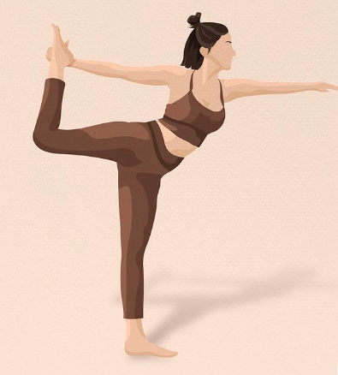
SOLUTION AND BENEFITS
Solution | Benefits
Tailored Fitness Programs | Improved physical health and overall well-being.
Happiness-Driven Activities (Yoga, Zumba, etc.) | Enhanced joy, reduced stress, and increased happiness.
Engaging Community Building | Meaningful connections, support, and empowerment among members.
Personalized Guidance and Coaching | Increased motivation, guidance, and confidence in fitness journeys.

Slide 10
COMPETITIONA ANALYSIS
Competitor | Product | UVP | Price (INR) | Market Review | Acceptance | Rating
HerSheFitness | Online fitness platform for women of all ages | Personalized workouts, expert guidance, community support | 1500 | Growing market for women's fitness | High acceptance among target audience | 4.5
CultFit | On-demand fitness platform with group classes | Wide variety of classes, convenient scheduling, experienced trainers | 2000 | Established player in the fitness industry | Widespread acceptance | 4.2
Fit & Flash | Women's-only fitness studio with dance-based workouts | Fun and energetic workouts, supportive environment, focus on weight loss | 2500 | Niche market with growing popularity | Positive feedback from members | 4.7
Women Fitness India | Online fitness platform with focus on Indian women's health | Culturally relevant workouts, expert guidance on nutrition and Ayurveda | 1800 | Emerging player with a focus on underserved market | Gaining traction among target audience | 4.3
Your Fitness | Personalized fitness coaching and nutrition counseling | Customized plans, one-on-one support, holistic approach to wellness | 3000 | Boutique service with high satisfaction rates | Widespread acceptance
Your Venture | Holistic fitness and wellness program for mid-aged women in India | Comprehensive approach to fitness, yoga, fun activities, and bonding time | 1700 | Emerging market with high potential | Targeted approach and unique value proposition | 3.9

Slide 11
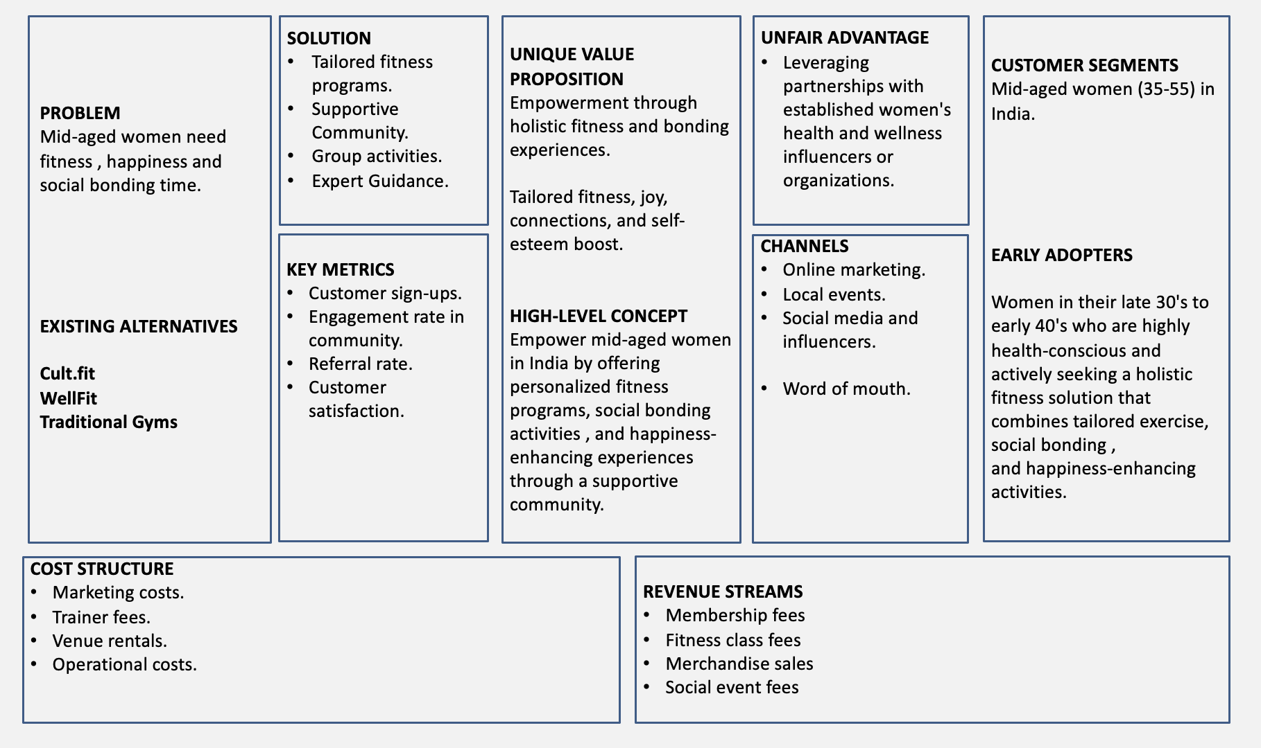
LEAN CANVAS MEET

Slide 12
MINIMUM VIABLE PRODUCT(MVP)
Feature | Description
Tailored Fitness Programs | Customized workout plans catering to varying fitness levels and goals of mid-aged women.
Happiness-Driven Activities | Offer yoga sessions, Zumba classes, or other enjoyable activities promoting happiness and well-being.
Community Building | Establish an online platform or forum for community interaction, support, and shared experiences.
Personalized Guidance | Provide expert guidance from fitness instructors or nutritionists for individualized support.

Slide 13
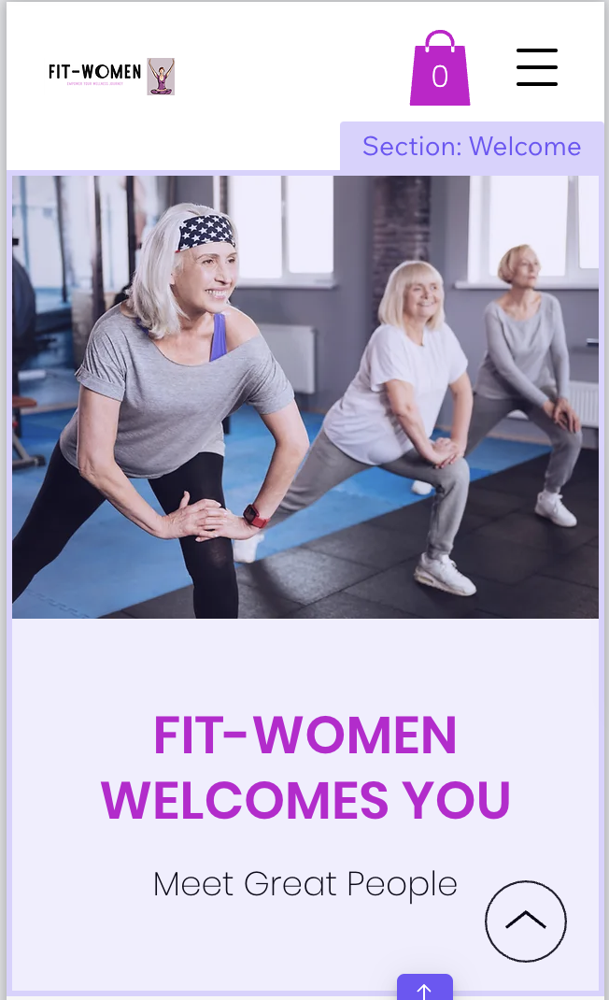
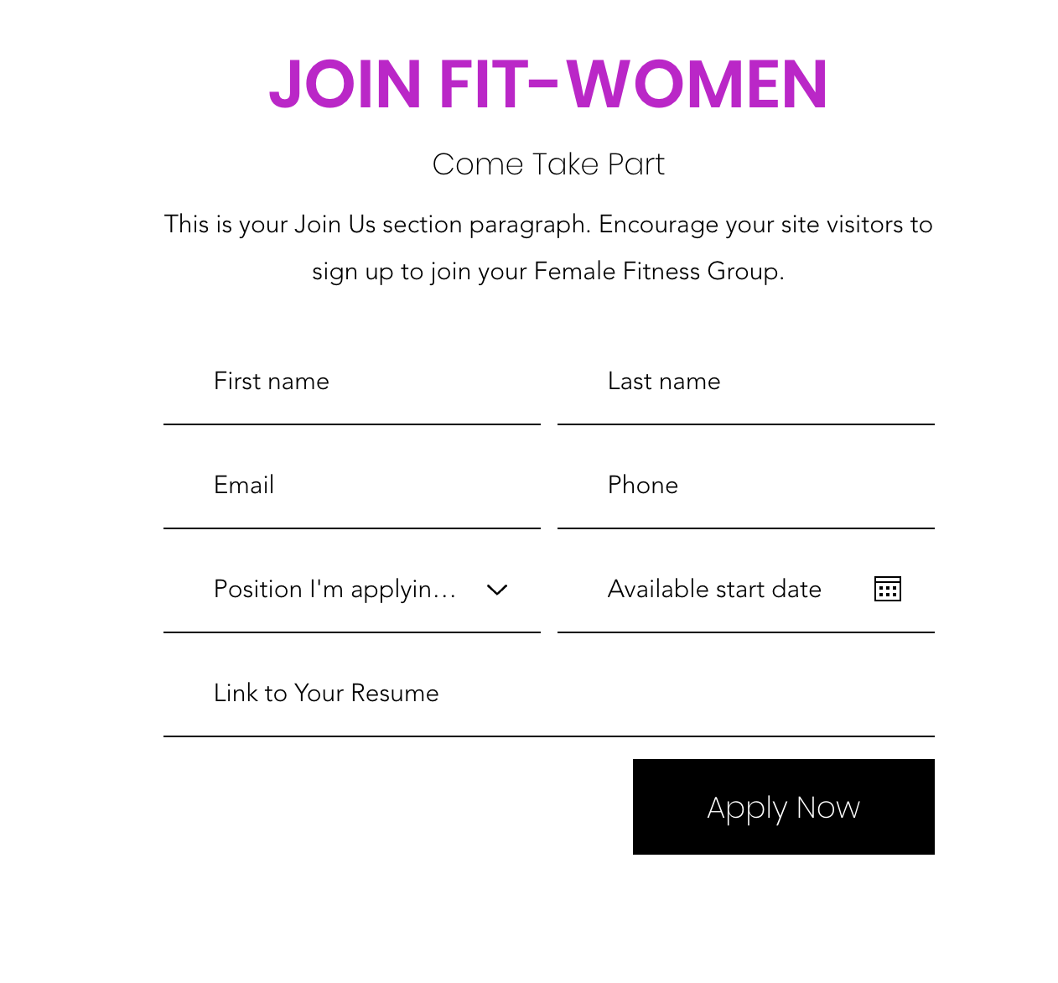
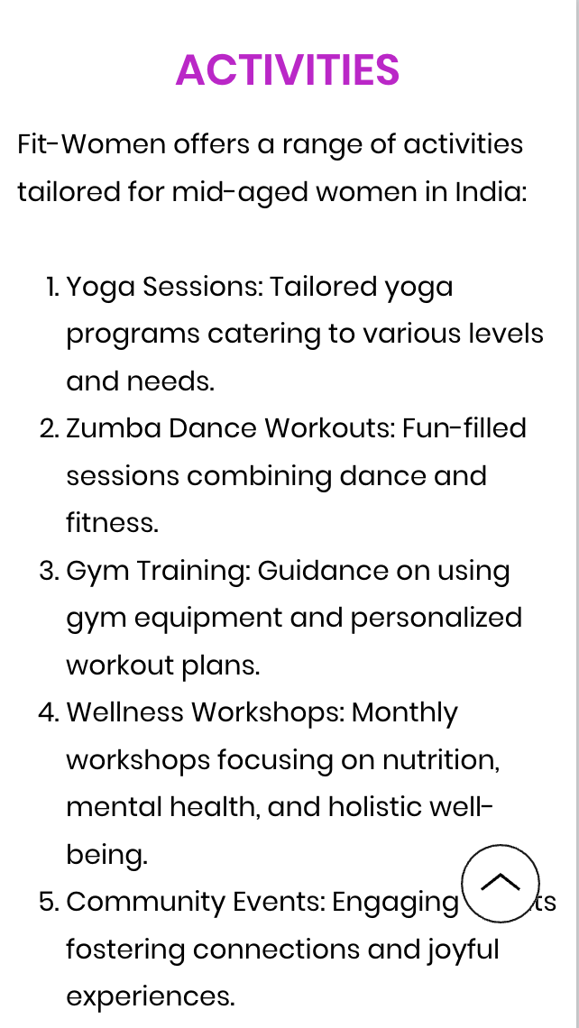
MVP –WEBSITE VIEW :
LINK

Slide 14
MVP VALIDATION
What is Your MVP?
The MVP, Fit-Women, is a combination of in-person fitness classes, happiness-enhancing activities, and community events targeting mid-aged women in India.
It focuses on addressing holistic well-being by offering tailored fitness programs and opportunities for social bonding.
Test Details:
How Long Will We Test This MVP?
The MVP testing phase will extend for 12 weeks.
The initial duration allows for a comprehensive assessment of user engagement and satisfaction.
Who Is Our Target Audience for the Test?
Our target audience for the MVP test is mid-aged women in India aged between 35 and 55.
These women are seeking fitness, happiness, and social bonding experiences.
How Many of Them?
We aim to test the MVP with an initial group of 100 participants.
This sample size will provide valuable insights into the feasibility and appeal of our fitness and community activities among the target audience.
How Will We Get to That Audience?
We will reach our audience through a targeted social media campaign, local event promotions, and word of mouth referrals.

Slide 15
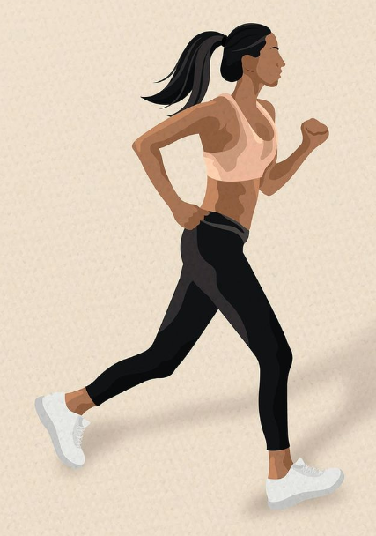
MVP VALIDATION
Parameter | Description | Score
Target Audience Relevance | Clear and defined target audience for the MVP | 5
Uniqueness of Value Proposition | Unique value compared to existing solutions | 4
Market Potential | Large enough market for sustaining a successful business | 4
Competitive Advantage | Sustainable advantage over competitors | 4
Problem-Solution Fit | Effective solution to a real and pressing problem for the audience | 4
Technical Feasibility | Feasibility of development within resources and timeframe | 4
Operational Feasibility | Sustainable operation and maintenance | 4
Financial Viability | Viable financial model for generating sustainable profits | 3
Customer Acquisition Strategy | Clear and effective plan for acquiring customers | 3
Marketing and Sales Plan | Well-defined strategy for marketing and sales to target audience | 3

Slide 16
Sales Plan
Customer Sales Funnel
TARGET MARKET:
30,00,000
OPPORTUNITIES/PROSPECTS:
10,000
CUSTOMER:
5,000
LEADS:
20,000
Customer Acquisition Plan
Target Customer Segment | Target Customer Segment (Number) | Channels to Attract | Estimated Leads | Estimated Cost to Convert
Mid-aged women (35-55) | 100,000 | Social Media, Fitness Events, Influencer Partnerships | 20,000 | ₹5,00,000
Working Professionals | 50,000 | Corporate Partnerships, Online Ads, Referral Programs | 10,000 | ₹3,00,000
Health Enthusiasts | 30,000 | Fitness Conferences, Collaborations with Health Brands | 6,000 | ₹2,00,000
Stay-at-home Moms | 20,000 | Local Community Events, Mom Blog Collaborations | 4,000 | ₹1,50,000

Slide 17
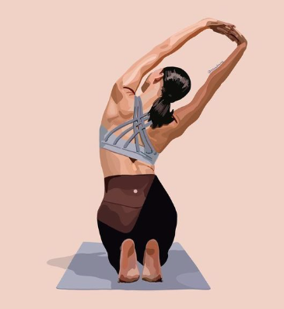
Go-to-Market Strategy
Strategy Element | Description
Target Audience | Mid-aged women (35-55) interested in fitness and wellness
Unique Value Proposition | Holistic wellness, personalized fitness, community bonding
Marketing Channels | Social media, influencers, fitness events, partnerships
Customer Acquisition Plan | Free trial sessions, referral programs, membership discounts
Launch Timeline | Pre-launch campaign, soft launch, official launch event
Metrics for Evaluation | Conversion rates, customer engagement, retention rates

Slide 18
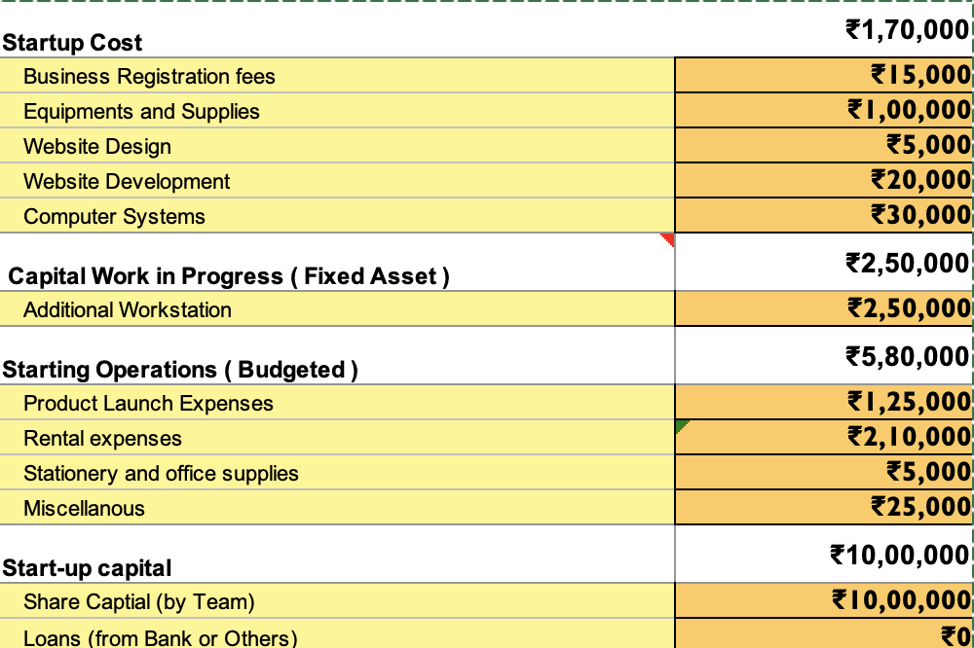
FINANCIAL PLAN
START-UP COST
The price point of ₹1700 is set after thorough analysis, considering competitive pricing and ensuring affordability for users. This balance ensures competitiveness in the market while remaining accessible to our audience, fostering both value and accessibility.
LINK

Slide 19
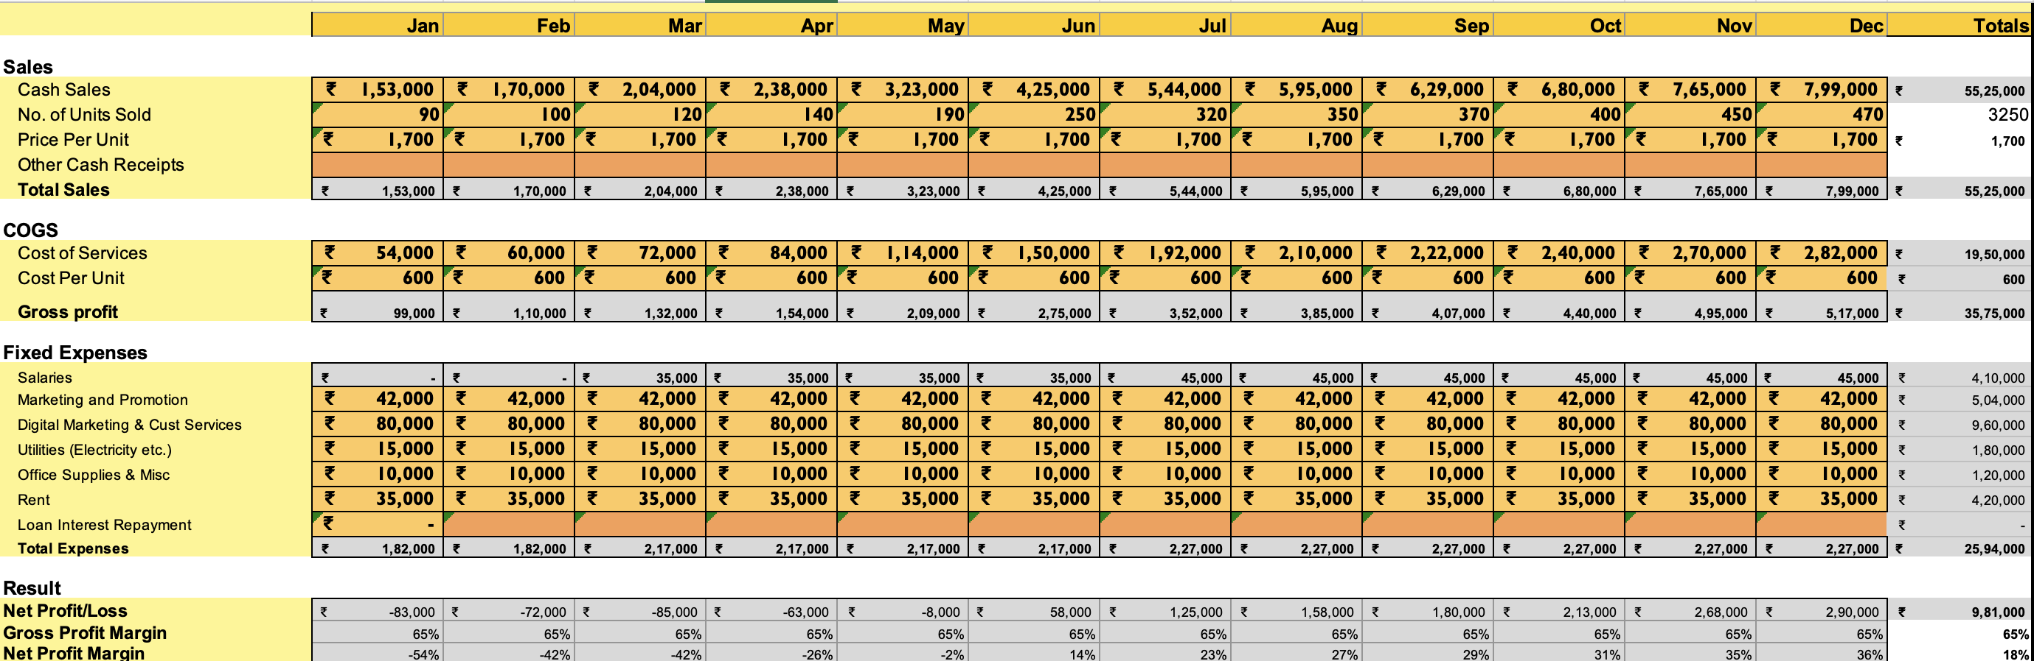
FORECAST P&L
LINK

Slide 20
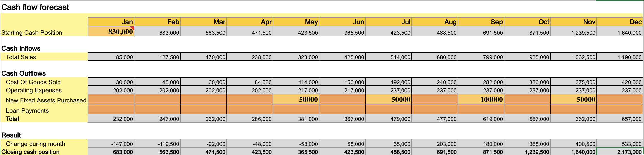
CASH - FLOW

Slide 21
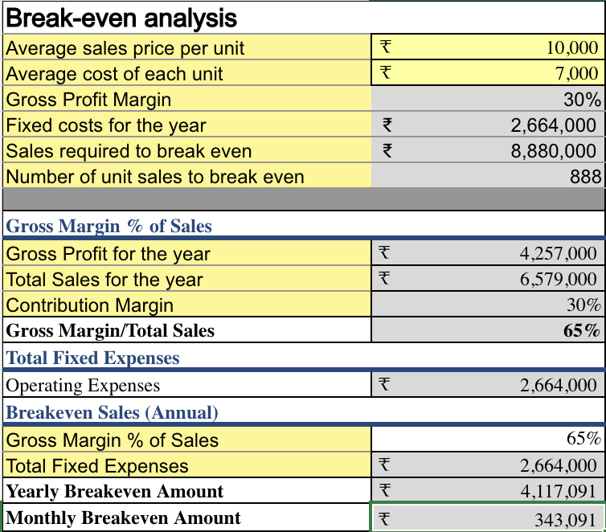
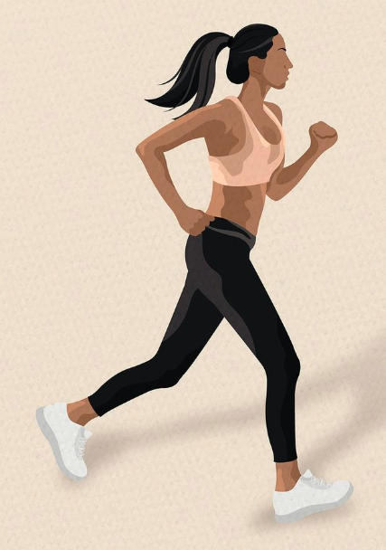
BREAK-EVEN ANALYSIS

Slide 22
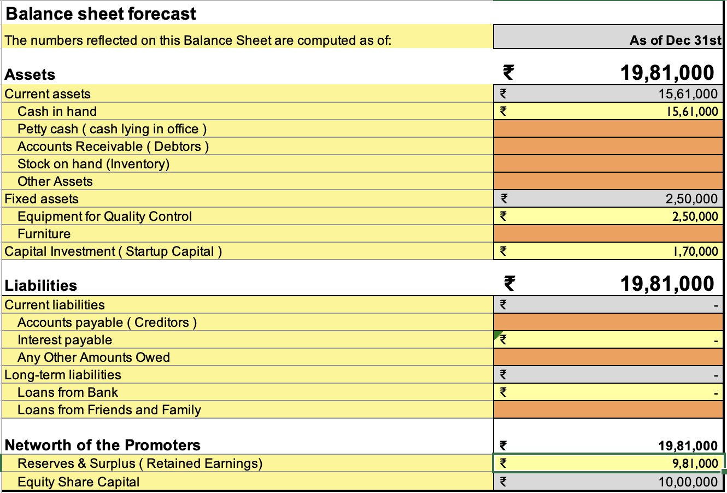
FINANCIAL PROJECTIONS
Fit-Women anticipates sustainable growth through tailored fitness offerings, community engagement, revenue from memberships, and strategic collaborations, ensuring holistic wellness for mid-aged women in India.

Slide 23
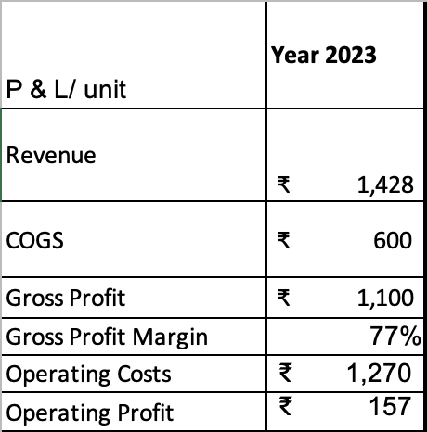
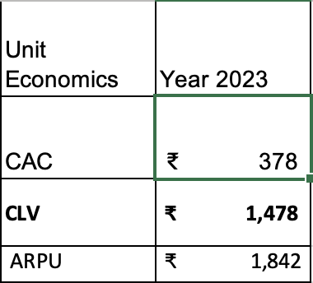
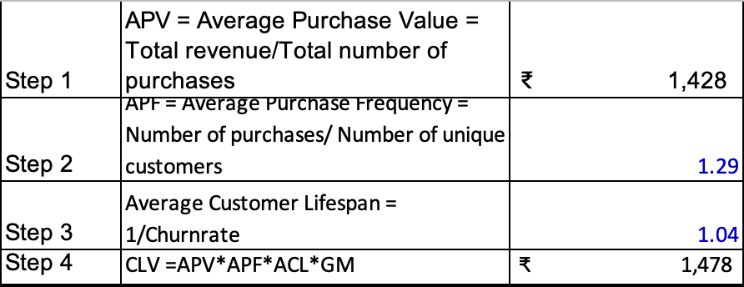
UNIT ECONOMICS
​Terms | Explanation (For the actual calculations, refer to the Financial Plan Excel sheet link)​
CAC​ | (Cost of Sales + Cost of Marketing ) / Number of new customers acquired (in currency terms)​
CLV | Average purchase value x Average purchase frequency x Average Customer Lifespan x Gross Margin
ARPU​ | Total revenue in specific period/Total number of customers during the same period (in currency terms)​
GROSS PROFIT​ | Total revenue – Total COGS (In currency terms)​
OPERATING COSTS | Cost of goods sold (COGS) + operating expenses (OPEX)
OPERATING PROFIT | Revenue from Core Operations – Cost of Goods Sold – Operating Expenses – Depreciation – Amortization Expenses
CHURN RATE | (Customers at the beginning of the period – customers at the end of the period) / customers at the beginning of the period

Slide 24
Branding , Positioning and Channels
Fit-Women is the holistic haven for India's mid-aged women, curating personalized fitness journeys within a joyous community, guided by experts, fostering wellness, and vibrant connections.
Aspect | Description
Brand Essence | Empowering Wellness
Brand Promise | Tailored Fitness, Joyful Community, Expert Guidance
Brand Values | Empathy, Personalization, Inclusivity
Brand Personality | Nurturing, Vibrant, Supportive
Brand Position | Bridging Wellness & Community for Mid-Aged Women
Brand Voice | Encouraging, Knowledgeable, Warm
Visual Identity | Vibrant colors, Modern yet approachable fonts, Inclusive imagery
Brand Experience | Personalized fitness plans, Engaging community events, Expert support and guidance
Brand Slogan | "Wellness United, Joy In Motion"

Slide 25
FUNDING PLAN
Infrastructure Development: ₹8 lakhs - Facilities setup and equipment.
Marketing & Outreach: ₹5 lakhs - Advertising and community engagement.
Expert Guidance: ₹3 lakhs - Hiring fitness coaches and nutritionists.
Technology Investment: ₹4 lakhs - App development and maintenance.
Community Events: ₹2 lakhs - Organizing wellness workshops and gatherings.
Funds Required for Next Level: Approx. ₹30 lakhs for growth.
Bootstrapped Amount: Seeking ₹10 lakhs for infrastructure setup.
Bootstrapping Potential: Limited to ₹5 lakhs.
External Funding Needed: Seeking ₹20 lakhs for substantial expansion.

Slide 26
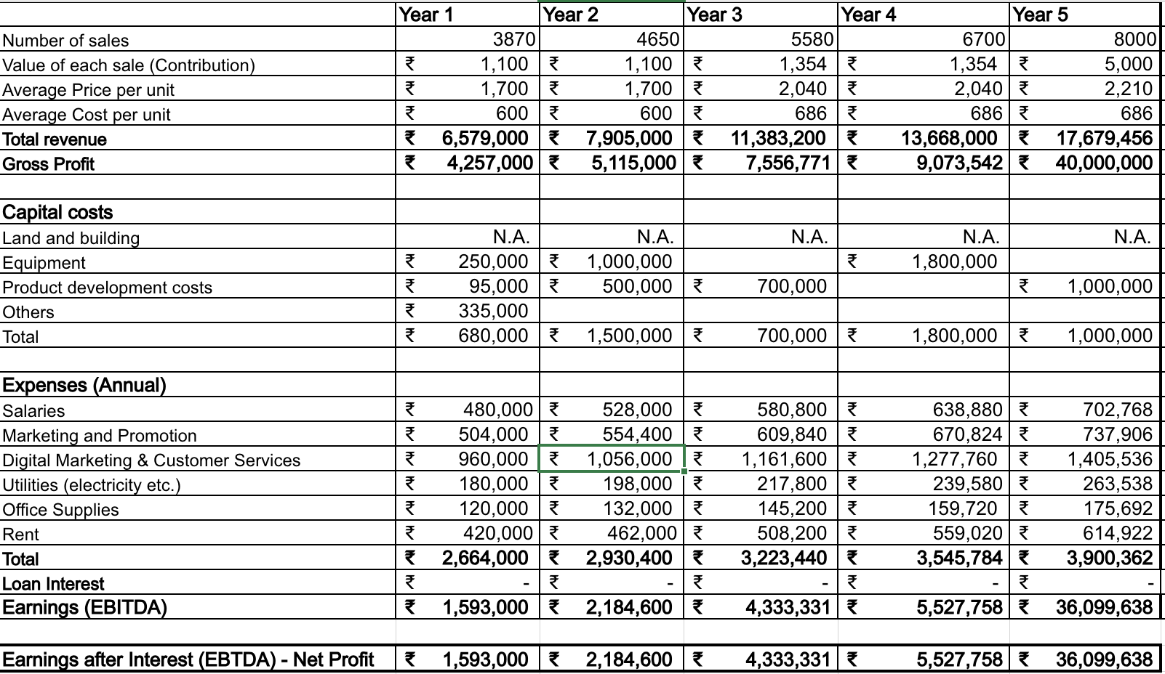
5 – YEAR PROJECTION

Slide 27
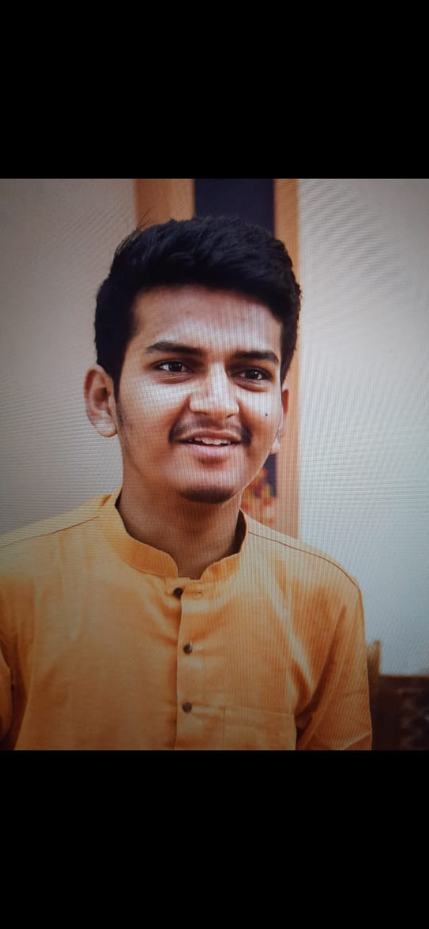
FOUNDER AND CEO – AADI VIKRAM
Aadi Krishna Vikram embodies visionary leadership, blending expertise in fitness, business acumen, and a passion for holistic wellness. His strategic mindset, coupled with a deep understanding of mid-aged women's needs in India, positions him aptly as the founder and CEO, driving Fit-Women's success with innovation and empathy.

Slide 28

THANKYOU

